Slide 1

THE KEY ATTRIBUTES OF AN IDEAL COMPLEX ENGINEERING SOFTWARE PROGRAMME
Jaspal Kang, Emily Rafter, Natasha Williams
Sirius Analysis Ltd.
© Crown Owned Copyright 2025.
Supplied to MOD under DEFCON 703 in accordance with Contract No DSTL/AGR/01142/01, Task 339.
Notes:
Welcome to this presentation.
Introduce myself. Jaspal has worked at Sirius for almost 2 years now.
Presentation given by Sirius Analysis.

Slide 2

Introduction
This presentation gives an overview of a project our team completed during 2023-2024 under the Dstl ASTRID framework.
This presentation will cover:
Introduction to the Project
Methodology Used
Case Studies and Analysis
The Key Attributes of an Ideal Complex Engineering Software Programme
Project Outcomes
Questions
Please leave any questions to the end.
2
Notes:
Introduce the ASTRID framework – industry can collaborate with UK MOD
This task was a successful collaboration between Dstl and Sirius.
Introduce the outline of the presentation.
Why are we presenting? -
Example of softer OR mention lit review
Lessons learned can be applied to other proogrammes
- Showcasing the OR approach and coloration between industry and MOD

Slide 3

Project Introduction
Global Combat Air Programme (GCAP) is a large, multi-national collaborative complex engineering procurement of a sixth-generation air system, being conducted by Japan, Italy and UK.
For the UK, GCAP will be the core component of the Future Combat Air System (FCAS).
Software represents a significant risk to complex engineering projects like FCAS, so there was a strong desire to understand and apply software lessons from previous similar endeavours.
UK MOD’s Defence Science and Technology Laboratory (Dstl) previously conducted an informal analysis of reports published by the US Government Accountability Office relevant to the F-35 procurement.
Our team enhanced the previous findings through an in-depth open-source literature review and analysis.
3
Notes:
Run through the points on the slide.
Lessons learned are things which can be taken from one project or activity and applied to another so we avoid making the same mistakes and also repeat good ways of working. For example, ways of testing software or good collaboration between customers and suppliers.

Slide 4
Research Objectives
To identify and compile relevant complex engineering case studies that rely on software.
To extract programme and software challenges and strengths from each case study.
To analyse common patterns, challenges, and best practices for software within complex engineering projects.
To provide lessons learned relevant to FCAS and other relevant complex engineering projects.
4
Notes:
Highlight these points

Slide 5
Task Approach
Case Study Selection
14 case studies identified
4 case studies selected
Source Identification and Assessment
Literature Review
Data Capture
Thematic Analysis
Lessons Learned
117 identified
59 sources reviewed
3,465 pages
674 datapoints collected
4 categories
11 topics
31 themes
6 for Software
3 for Wider Engineering
Key Attributes of an Ideal Complex Engineering Software Programme
5
Notes:
Overall approach to the task which I will describe in more detail

Slide 6
Task Approach
Case Study Selection
14 case studies identified
4 case studies selected
Source Identification and Assessment
Literature Review
Data Capture
Thematic Analysis
Lessons Learned
117 identified
59 sources reviewed
3,465 pages
674 datapoints collected
4 categories
11 topics
31 themes
6 for Software
3 for Wider Engineering
Key Attributes of an Ideal Complex Engineering Software Programme
6
Notes:
14 initial case studies identified which included: (Heathrow Terminal 5, A440M transport aircraft, and NATO Air Command and Control System. )
These were assessed on the amount & quality of openly available information, relevancy (how the content could be applied or used by FCAS), & variety (the number of different viewpoints or sources from different places).
From these, the four case studies for in-depth research were chosen, which were the UK Elizabeth Line, the US Expeditionary Combat Support System, the UK Emergency Services Network and the F-35 procurement. We will look at these case studies in more detail in a few slides.

Slide 7



Task Approach
Case Study Selection
14 case studies identified
4 case studies selected
Source Identification and Assessment
Literature Review
Data Capture
Thematic Analysis
Lessons Learned
117 identified
59 sources reviewed
3,465 pages
674 datapoints collected
4 categories
11 topics
31 themes
6 for Software
3 for Wider Engineering
Key Attributes of an Ideal Complex Engineering Software Programme
7
Notes:
A key word search was conducted on sites & repositories like Janes (open source defence intelligence website), and the UK National Audit Office (NAO).
Sources were assessed using a Red Amber Green (RAG) system to remove any irrelevant, bias, or poor-quality sources.
Reference mining (using bibliographies to find more relevant data sources) was also used.

Slide 8
Task Approach
Case Study Selection
14 case studies identified
4 case studies selected
Source Identification and Assessment
Literature Review
Data Capture
Thematic Analysis
Lessons Learned
117 identified
59 sources reviewed
3,465 pages
674 datapoints collected
4 categories
11 topics
31 themes
6 for Software
3 for Wider Engineering
Key Attributes of an Ideal Complex Engineering Software Programme
8
Notes:
A lot of reading!

Slide 9
Task Approach
Case Study Selection
14 case studies identified
4 case studies selected
Source Identification and Assessment
Literature Review
Data Capture
Thematic Analysis
Lessons Learned
117 identified
59 sources reviewed
3,465 pages
674 datapoints collected
4 categories
11 topics
31 themes
6 for Software
3 for Wider Engineering
Key Attributes of an Ideal Complex Engineering Software Programme
9
Notes:
Across the sources reviewed, 674 datapoints were collected.
An Excel database captured these data points, and the relevant source information.

Slide 10
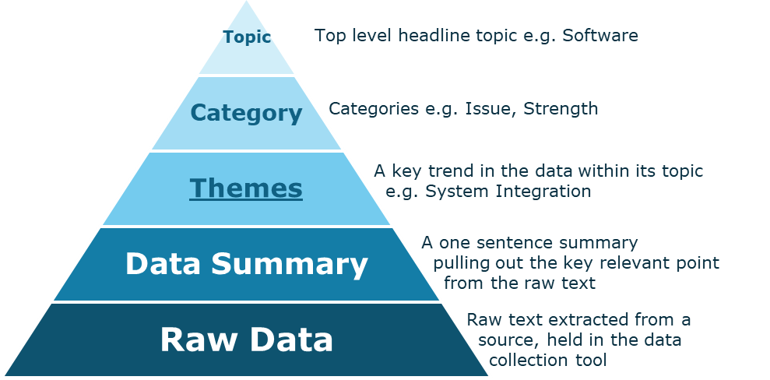
Task Approach
Case Study Selection
14 case studies identified
4 case studies selected
Source Identification and Assessment
Literature Review
Data Capture
Thematic Analysis
Lessons Learned
117 identified
59 sources reviewed
3,465 pages
674 datapoints collected
4 categories
11 topics
31 themes
6 for Software
3 for Wider Engineering
Key Attributes of an Ideal Complex Engineering Software Programme
10
Notes:
Thematic analysis (analysing text-based data for common topics and patterns) was conducted to find common themes between case studies.
The datapoints were then mapped & grouped to a hierarchy. This allowed the text-based themes to be quantified, which allowed us to create data visualisations which we’ll see in a few moments.

Slide 11
Task Approach
Case Study Selection
14 case studies identified
4 case studies selected
Source Identification and Assessment
Literature Review
Data Capture
Thematic Analysis
Lessons Learned
117 identified
59 sources reviewed
3,465 pages
674 datapoints collected
4 categories
11 topics
31 themes
6 for Software
3 for Wider Engineering
Key Attributes of an Ideal Complex Engineering Software Programme
11
Notes:
Next, the lessons learned were grouped together, leading to 6 lessons identified specifically for Software, & 3 for Wider Engineering.

Slide 12
Task Approach
Case Study Selection
14 case studies identified
4 case studies selected
Source Identification and Assessment
Literature Review
Data Capture
Thematic Analysis
Lessons Learned
117 identified
59 sources reviewed
3,465 pages
674 datapoints collected
4 categories
11 topics
31 themes
6 for Software
3 for Wider Engineering
Key Attributes of an Ideal Complex Engineering Software Programme
12
Notes:
The outputs of the research & analysis were turned into a set of consolidated recommendations for FCAS, GCAP & other complex engineering programmes to follow.

Slide 13



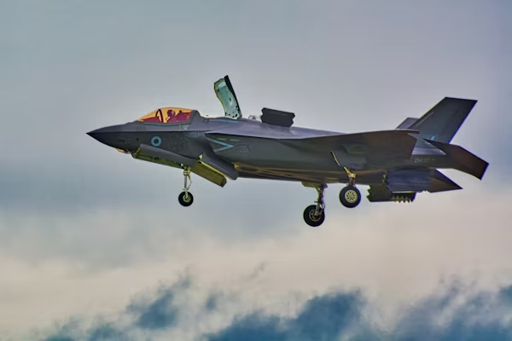
Case Studies
The Elizabeth Line (EL)
The Expeditionary Combat Support System (ECSS)
The Emergency Services Network (ESN)
Lightning II Joint Strike Fighter Programme (F-35)
Case Studies were down-selected with the customer, to include a variety of:
  Defence & non-defence
  Outcomes i.e. successful, cancelled, & ongoing
  Software & Engineering focussed
This provided a breadth of insights and lessons learned.
  A high-frequency urban-suburban rail service located in the Southeast of England, and the UK’s first digital railway.
  Built between 2009 and 2023.
  Outcome: Successful but had major delays.
  Undertaken by the US Air Force with the aim of streamlining logistics operations and replacing over 200 legacy systems.
  Program ran between 2004 and 2012.
  Outcome: Cancelled, due to insufficient progress and high spending.
  A UK Home Office current programme to provide a new voice and data communications network for the Emergency Services.
  Program started in 2015 and is expected to deliver in 2029.
  Outcome: Ongoing, contract changes already taken place.
  Procurement of fifth-generation strike fighter aircraft that integrates stealth, advanced sensors and networking.
  Program started 2001. 900 aircraft delivered (as of 2023).
  Outcome: Ongoing, large fleet with many flying hours, but challenges remain.
13
Notes:
Walk through what the case-studies were:
What was/is the aim?
The dates
The status
Any major events (delays[COVID, 5 year schedule slip, programme reset]
US Senate investigation – failure to follow the best practice guidelines.

Slide 14
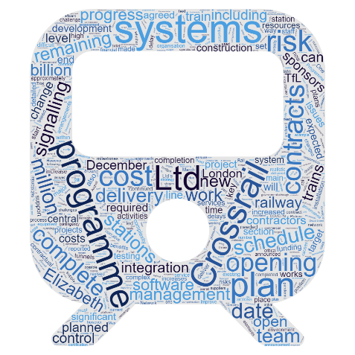
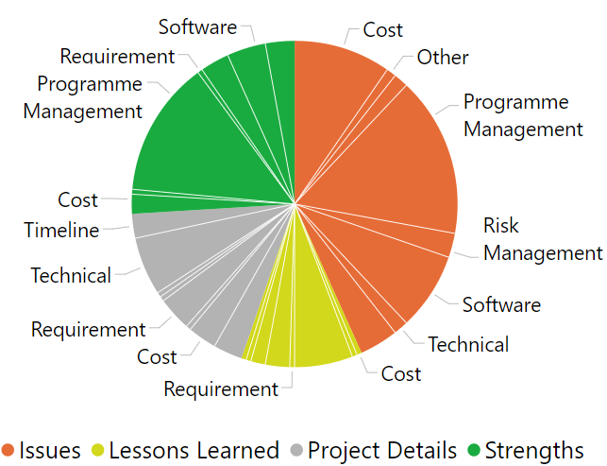
Example Data Visualisations (1)
Word Clouds
Measures frequency of ‘non-filler’ words from all datapoints.
Repeating key terms stand out.
Effective way of engaging a wide audience.
2. Categorical Pie Chart
Breaks down category and topic.
Highlights narrative of the topics within the literature.
Comparison between the case studies.
14
Notes:
Explain what the visualisations show
Explain what they were used for
These are ways of communicating text-based data in a quantitative way.

Slide 15
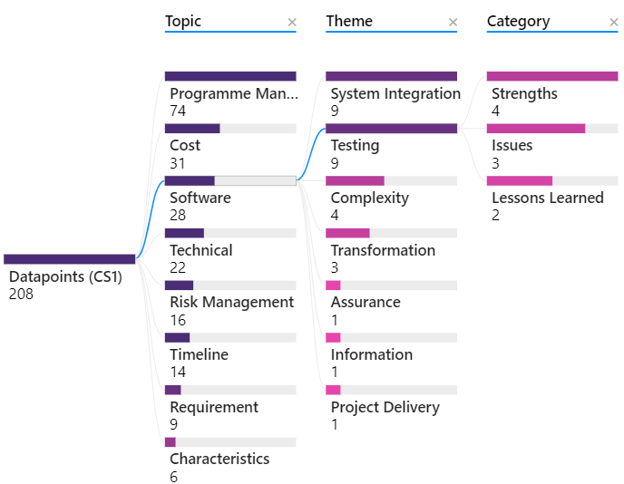
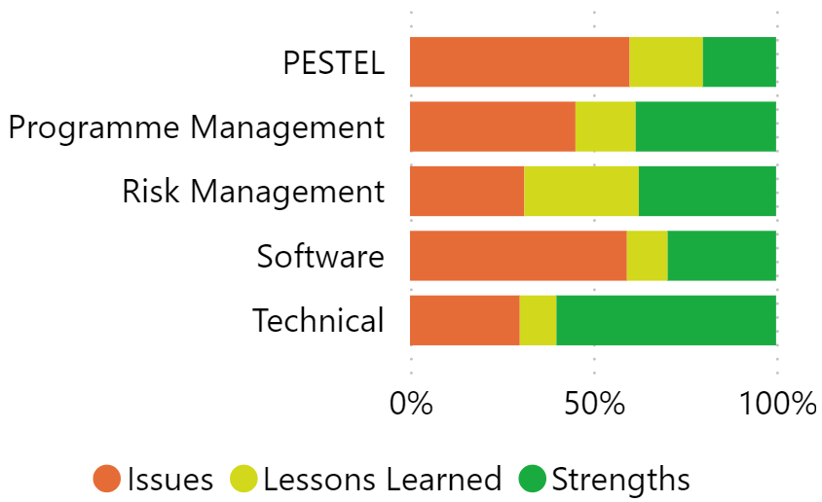
Example Data Visualisations (2)
3. Topic and Category Breakdown
From selected topics, the breakdown of datapoints by category.
Understand narrative of the case studies from literature.
Comparison between the case studies.
4. Thematic Decomposition Tree
Displays frequency of topics, categories and themes.
Strong visual tool for exploring subsets of data.
15
Notes:
Explain what the visualisations show
Explain what they were used for
These are ways of communicating text-based data in a quantitative way.

Slide 16
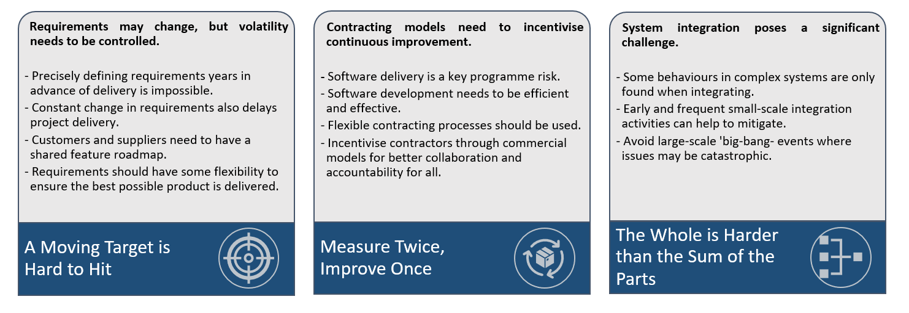
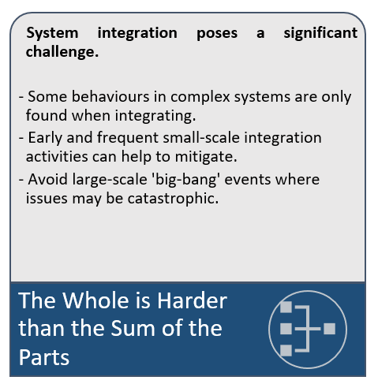
Recommendations (1)
The Key Attributes of an Ideal Complex Engineering Software Programme:
16
Notes:
#1 Requirements may change, but volatility needs to be controlled.
In programmes that are long (sometimes decades long), and precisely defining what is needed, years in advance is practically impossible. Similarly, changing everything before anything is actually delivered is madness. Software architectures need to minimise the impact of a change, and software processes need to allow delivery timescales to be given with confidence. Customers and suppliers need to work together on a shared, regularly-updated feature roadmap that has a suitable level of flexibility in the requirements so they aren’t completely concrete or entirely fluid.
#2 Contracting models need to incentivise continuous improvement.
Software delivery is a key programme risk and is key to operational effectiveness. Software development processes need to be efficient and effective, allowing flexible contracting approaches to be used. Incentivising industry through contracting models from the beginning will ensure the program gets the software outputs it needs, and promotes better collaboration and accountability.
#3 System integration poses a significant challenge.
By their very nature, complex systems can show behaviours for the first time at the point of system integration. Late discovery of significant issues should be managed, by conducting early and frequent small-scale integration activities, avoiding large-scale big-bang events where the discovery of issues may be catastrophic.

Slide 17
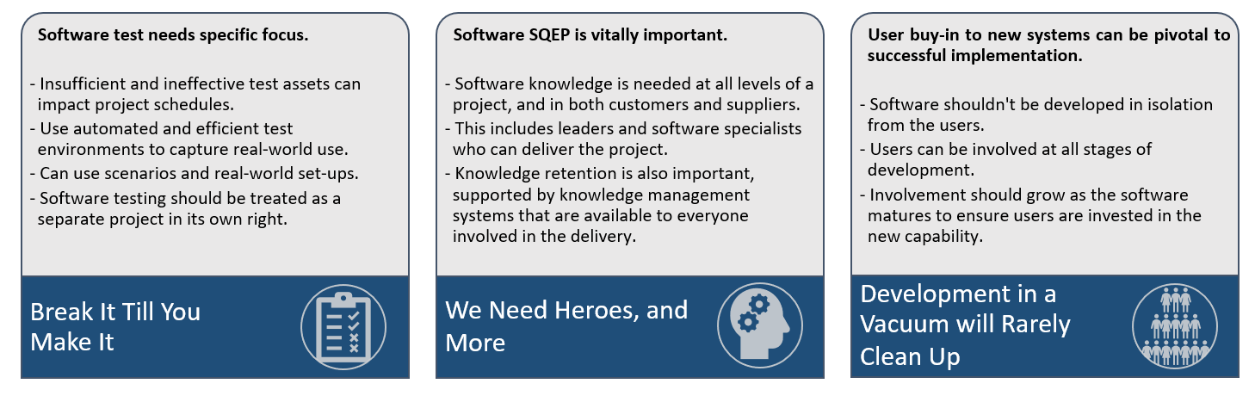
Recommendations (2)
The Key Attributes of an Ideal Complex Engineering Software Programme:
17
Notes:
#4 Software test needs specific focus.
Insufficient and ineffective test assets can impact programme schedule. Frequent software releases demand frequent use of automated and efficient test environments, which adequately capture the subtleties of real-world use for example through the use of scenarios or realistic equipment configurations. This collection of testing environments should be planned and delivered as if it were a separate project.
#5 Software SQEP is vitally important.
Complex engineering endeavours demand software knowledge at all levels and across all parties. This includes software-knowledgeable leaders, who can instil the importance of software throughout the programme. It also includes software specialists within the customer organisation, who are able to mitigate risks and seize opportunities. Knowledge retention is also vitally important, and supported by strong information and knowledge management systems that communicate across the programme.
#6 User buy-in to new systems can be pivotal to successful implementation.
Development of software products in isolation from user communities risks unsuccessful implementation and integration. Users can be included from the earliest stages of development to gather an understanding of where current capabilities don’t meet their needs. As programmes mature towards delivery, user involvement should grow to get their investment in what is to be achieved with the new capability.

Slide 18
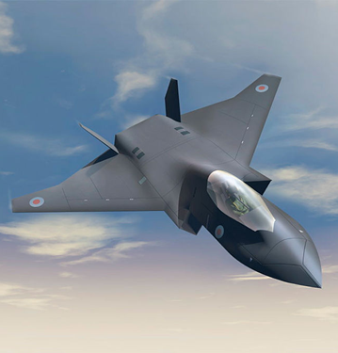
Project Outcomes
Delivered a standardised methodology that can be repeated for additional case studies in the future.
Identified complex software engineering lessons learned that can be applied within FCAS. It generated six ‘key attributes’ that others should look to adopt.
Will go on to inform the future shape of the FCAS software engineering programme.
Demonstration of strong collaboration between the UK Defence customer and Industry.
The outputs can be published through open-source mechanisms, such as conferences and academic papers.
A clear demonstration of the power of open-source research and how unclassified material can inform complex Defence procurements.
18
Notes:
This project identified complex software engineering lessons learned that can be applied within FCAS. It generated six ‘key attributes’ (as covered in the previous slides) that others should look to adopt.
Will go on to inform the future shape of the FCAS software engineering programme.
Demonstration of strong collaboration between the UK Defence customer and Industry. Produced an ongoing relationship to demonstrate the work achieved.
The outputs can be published open-source, such as in conferences and academic papers.
A clear demonstration of the power of open-source research and how unclassified material, including on non-Defence topics, can inform complex Defence developments and procurements.
Agree and develop a standardised methodology upfront that can easily be repeated. The team designed and delivered tools, templates, and processes that can be repeated for additional case studies in the future.
Data visualisation of qualitative information can be achieved successfully with extensive thematic analysis. This was useful to present key information from vast amounts of text.
The findings are only as rich as the literature review. It’s important to spend the time conducting the research to ensure value is generated and the right case studies are used.
There is huge value is learning the strengths and weaknesses of similar endeavors before initiating a project / programme. A variety in case studies can strengthen the breadth of lessons learned, identifying topics that might otherwise be missed.

Slide 19
Contact:
Jaspal Kang – jaspalkang@sirius-analysis.co.uk
Emily Rafter – emilyrafter@sirius-analysis.co.uk
Natasha Williams – natashawilliams@sirius-analysis.co.uk
Thank you for listening.
Any questions?
© Crown Owned Copyright 2025.
Supplied to MOD under DEFCON 703 in accordance with Contract No DSTL/AGR/01142/01, Task 339.

Slide 20







Observations From All Case Studies
Importance of Real World / Relevant Testing Scenarios [EL, ECSS, ESN, F-35]
  Use of real-world scenarios, realistic desktop configurations, & highly-effective software testing infrastructure.
Small Bang vs. Big Bang Integration [ECSS, ESN]
  Incremental approach rather than a singular radical change.
System Integration: Planning and Management [EL, ECSS, ESN, F-35]
  A clear understanding of how different systems or elements will integrate together. Planning schedules should give realistic timeframes for delivery.
Experienced People / Information and Knowledge Management [ECSS, ESN, F-35]
  Continuity of people supports better knowledge management & sharing.
User Buy-In [EL, ECSS, ESN]
  It can be challenging to implement change without buy-in from the users.
Requirements [ECSS, ESN, F-35]
  Requirements are likely to change over long programmes, especially software.
16
Notes:
Importance of Real World / Relevant Testing Scenarios
Ample time should be planned for and allocated to testing.
For example: the Elizabeth Line utilised realistic software configurations to test system performance without the need for the complete physical system being in place. The use of testing rigs allowed for the rapid testing of software and upgrade using approximate real-world environments.
Small Bang vs. Big Bang Integration
USAF thesis explored the impact of a small bang vs big bang approach.
ESN programme reset in 2018 to implement an incremental approach
System Integration: Planning and Management
Crossrail used plateau teams to manage the system integration ensuring integration occurred level by level.
On F-35 challenges were faced with 5 software blocks being developed and delivered in parallel, putting pressure into the integration phase.
Realistic timeframes included in the plans.
SQEP = Suitably Qualified and Experienced Personnel
SQEP / Information and Knowledge Management
Continuity of SQEP can support better information and knowledge management.
The ECSS programme experienced serious issues with retaining knowledge, as many people left and did not share their experience with others or found a way to distribute it through a knowledge management system. At the senior level this also led to a great deal of change with the requirements and expectations of the
User Buy-In
It can be challenging to implement change programmes successfully, especially those that are complex and transformational, without buy-in from the user and stakeholder communities.
Cultural resistance to change was an issue for ECSS, as users were not included within the development process. So when new systems were rolled out, they were not used.
Requirements
The requirements are likely to change over the duration of a software-dominant programme.
Programmes will benefit from maintaining a degree of flexibility within their software requirements and having robust procedures for dealing with change.
For example, have a clear end-goal for software requirements and a roadmap sat underneath them that can be developed as the programme matures.
This helps set reasonable delivery timelines which may include appropriate extensions for software testing.
On the ESN case study, data pointed to there not being a shared understanding between the customer and suppliers on the requirements and when things needed to be delivered. This has led to delays and poor products being provided that do not meet the needs of the customer and users.

Slide 21







Wider Engineering Findings
Commercial Constructs: Contracting models should allow for flexible approaches to be used and build openness and transparency between customer and supplier.
Performance Metrics: By using performance metrics delivery organisations promote accountability for the delivery of quality products, including software.
Risk Management: Establish a comprehensive risk management strategy, which identifies risks early, assesses impact, finds mitigations, and regularly reviews risks, and improves the chance of programme success.
Publication: Other complex engineering programmes, such as FCAS, should seek to publish suitable information in the public domain to support others, including studies like this one.
17
Notes:
Commercial constructs and metrics (and all) are interesting discussion points for NATO as they have difficulties in those areas
Commercial Constructs: Contracting models should allow for flexible approaches to be adopted and build in openness and transparency between customer and supplier.
Performance Metrics: By using performance metrics (accurate estimation and measurements) delivery organisations promote accountability for the delivery of quality products, including software.
Risk Management: Establishing a comprehensive risk management strategy, which identifies risks early, assesses impact, generates mitigations, and regularly reviews risks, significantly improves the chance of programme success.
Publication: This is an additional finding from the study methodology, rather than the data focussed ones extracted in the previous three bullets. Other complex engineering programmes, such as FCAS, should seek to publish suitable information in the public domain to support other programmes in a similar way as those used here. This study has produced great material and lessons learned for FCAS, and could be easily replicated by other programmes.

Slide 22
Q&A Prep
Role of AI in our research and analysis – future looking
More detail on the thematic analysis & quantifying text
Do we want some hidden appendix slides to aid any expected questions?
Did you consider any non-UK or NATO case studies? - NATO ACCS was considered, lack of access to data but could do in the future, important to get variety.
What next after this study? Could expand it to look at NATO and go back to dstl sponsor for follow on study etc. We’ve made templates which means this study can be easily replicated.
Are you able to share your data? With the permission of our customer, absolutely!
How can you get organisations to adopt these lessons? Showcasing our work and findings, at events just like this, are a great way to get organisations to adopt these lessons. By focussing on both strengths and weaknesses of other projects we’ve also been able to show the things you should do as well as mistakes to avoid. Successful outcomes from FCAS, should they adopt our recommendations, will help to promote the utility of these lessons learned.

